Slide 1

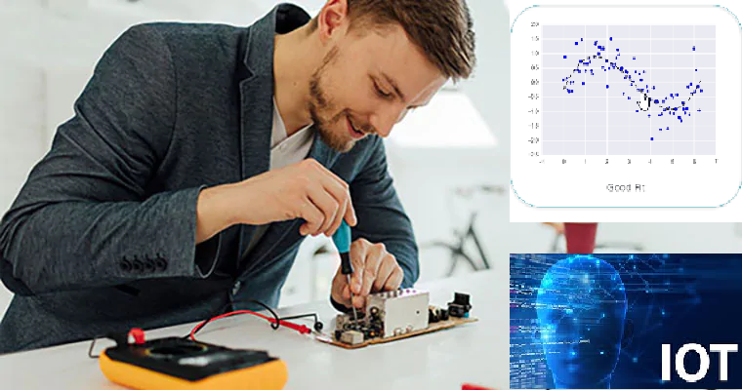



Wearable Devices and Computer Vision
Wednesday, June 2, 2020
Head Instructor: Jose Luis Ramirez Herran
TA’s: Souleymane Konate and Ricardo Villamil

Slide 2

Today’s Lecture
Break
7:40 pm – 7:50 pm
Break
8:40 pm – 8:50 pm
Part 1
Serial Terminal, Tutorial 1 Troubleshooting
Part 2
Computer Vision with OpenCV4
Anaconda Python
Image Processing with python
Questions
Part 3
Homework
Questions?
Projects and Teams
Logistics
Getting ready for tutorial 2
6:30 pm – 7:30 pm
7:50 pm – 8:40 pm
8:50 pm – 9:30 pm

Slide 3
Break
7:30 pm – 7:40 pm
6:30 pm – 7:30 pm
Part 1
Logistics
Serial Terminal, Tutorial 1 Troubleshooting
Getting ready for tutorial 2

Slide 4
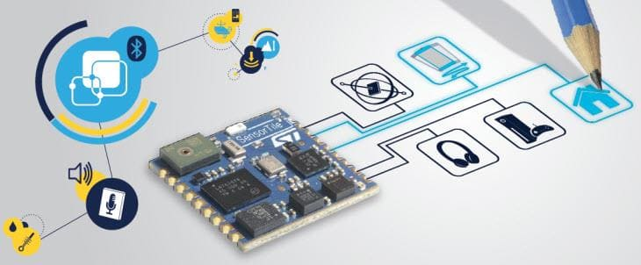
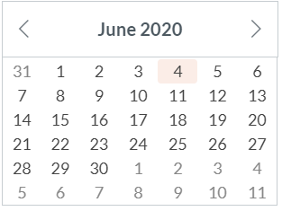
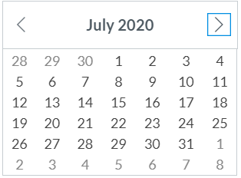
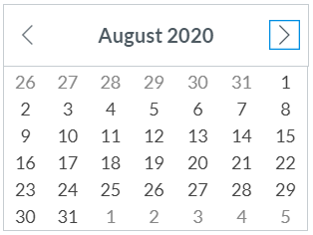
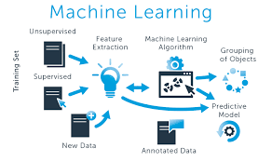

Calendar summer 2020
Mondays and Wednesdays 6:30 pm – 9:30 pm
Wearable Devices and Computer Vision
Project
presentations
Su M Tu W Th F S
SW+HW Setup.+ Basic Tutorials

Slide 5
Reminders
If you haven’t done so already, please take a couple of seconds and submit your location now in Canvas.
Please sign-up for piazza now.
Piazza2020Summer_Access_Codes:
Wearables code:
dgmds1434484
Class Signup Link:
piazza.com/extension.harvard/summer2020/dgmds1434484
Thanks

Slide 6
Bonus materials: Videos from summer 2019
As an excellent resource we will provide this year is the access to the Lectures from the summer of 2019.
During that semester, we focused a lot in the details about the software and the tutorials.
The video module is an excellent resource that could help you to answers many questions while you are experimenting with the machine learning embedded system: Sensor Tile. You can do this learning independently at your own pace in your own time-zone.

Slide 7
Part 1 Event Detection and Configuration, Accelerometer Sensor Systems and Orientation and Event Detection
June 29, 2020

Slide 8
Part 1. Outline
Serial Terminal Basics (Mac, Linux, Windows)
Review tutorial 1. Installing IDE, Importing STM32 projects, Building, Debugging, and Flashing a project, and the Datalog project.
Tutorial 2. Introduction to Sensor System Signals, Event Detection, and Configuration
Sensor signal acquisition and processing
Introduction to code development with the IDE and Sensor Tile

Slide 9
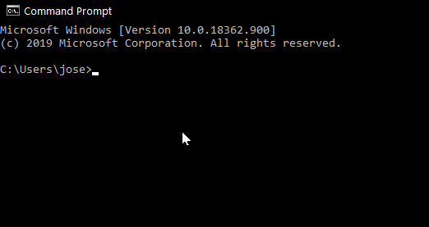
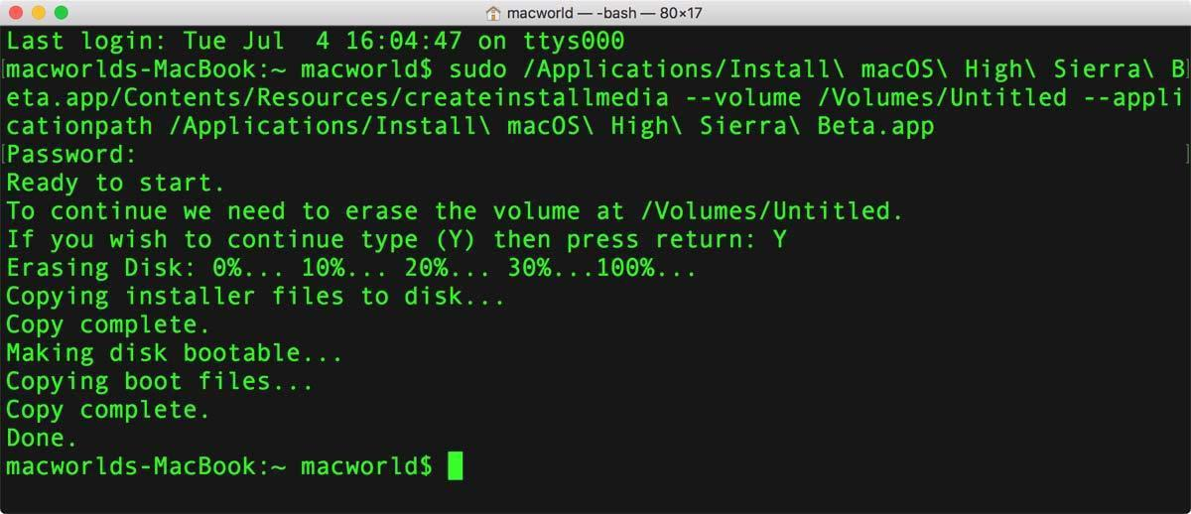
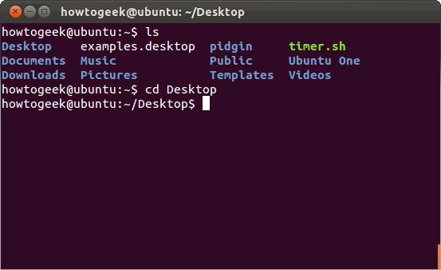
Serial Terminal Basics (Mac, Linux, Windows)
Please read:
https://learn.sparkfun.com/tutorials/terminal-basics/command-line-windows-mac-linux
for more details

Slide 10
Example in windows:
In the following sequence of commands, the Nucleo Board is connected and I am connecting and disconnecting the SensorTile USB cable from the PC. COM5 is the port assigned to the Nucleo Board and COM6 is assigned to the SensorTile Board.
C:\Users\jose>powershell
Windows PowerShell
Copyright (C) Microsoft Corporation. All rights reserved.
Try the new cross-platform PowerShell https://aka.ms/pscore6
. : File C:\Users\jose\Documents\WindowsPowerShell\profile.ps1 cannot be loaded because running scripts is disabled on
this system. For more information, see about_Execution_Policies at https:/go.microsoft.com/fwlink/?LinkID=135170.
At line:1 char:3
+ . 'C:\Users\jose\Documents\WindowsPowerShell\profile.ps1'
+ ~~~~~~~~~~~~~~~~~~~~~~~~~~~~~~~~~~~~~~~~~~~~~~~~~~~~~~~
+ CategoryInfo : SecurityError: (:) [], PSSecurityException
+ FullyQualifiedErrorId : UnauthorizedAccess
PS C:\Users\jose> [System.IO.Ports.SerialPort]::getportnames()
COM5
PS C:\Users\jose> [System.IO.Ports.SerialPort]::getportnames()
COM5
COM6
PS C:\Users\jose> [System.IO.Ports.SerialPort]::getportnames()
COM5
PS C:\Users\jose> [System.IO.Ports.SerialPort]::getportnames()
COM5
COM6
PS C:\Users\jose> [System.IO.Ports.SerialPort]::getportnames()
COM5
PS C:\Users\jose> [System.IO.Ports.SerialPort]::getportnames()
COM5
PS C:\Users\jose> [System.IO.Ports.SerialPort]::getportnames()
COM5
COM6
PS C:\Users\jose> [System.IO.Ports.SerialPort]::getportnames()
COM5
COM6

Slide 11
Example in the MAC:
In the here both the Nucleo Board and the SensorTile Board are connected. The Nucleo identifier finish in 14203 and the SensorTile finish in FFFF1 as you can notice.
(base) Joses-MacBook-Pro-5:~ jose$ ls /dev/tty.usb*
/dev/tty.usbmodem14203 /dev/tty.usbmodemFFFFFFFEFFFF1
After disconnecting the SensorTile, you will get only the Nucleo board as shown below
(base) Joses-MacBook-Pro-5:~ jose$ ls /dev/tty.usb*
/dev/tty.usbmodem14203
(base) Joses-MacBook-Pro-5:~ jose$
After you know which ports are available and which correspond to the SensorTile you can use Screen.

Slide 12
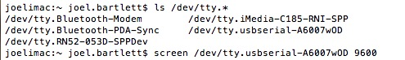
listen to SensorTile using Screen Command
You can now use the screen command to to establish a simple serial connection.
Type screen <port_name> <baud_rate> to create a connection.
The terminal will go blank with just a cursor. You are now connected to that port!
To disconnect, type control-a followed by control-\. The screen will then ask if you are sure you want to disconnect.

Slide 13
Linux
Linux also use Screen
The screen command can also be used in Linux. There are only a few variations from the Mac instructions.
If you do not have screen installed, get it with sudo apt-get install screen.
Making a connection is the same as Mac.
To disconnect, type control-a then shift-k.
That's all there is to it.
More details in: https://learn.sparkfun.com/tutorials/terminal-basics/command-line-windows-mac-linux

Slide 14
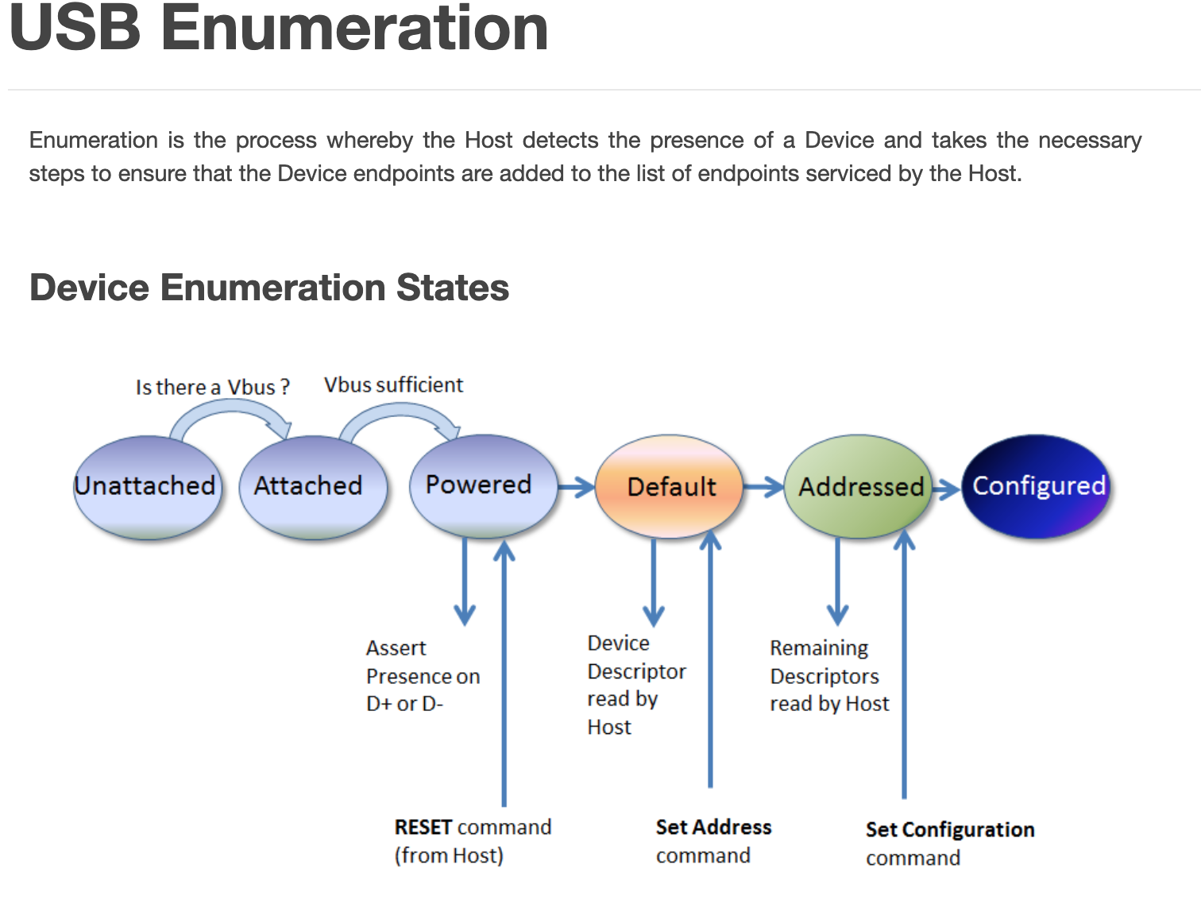

Slide 15
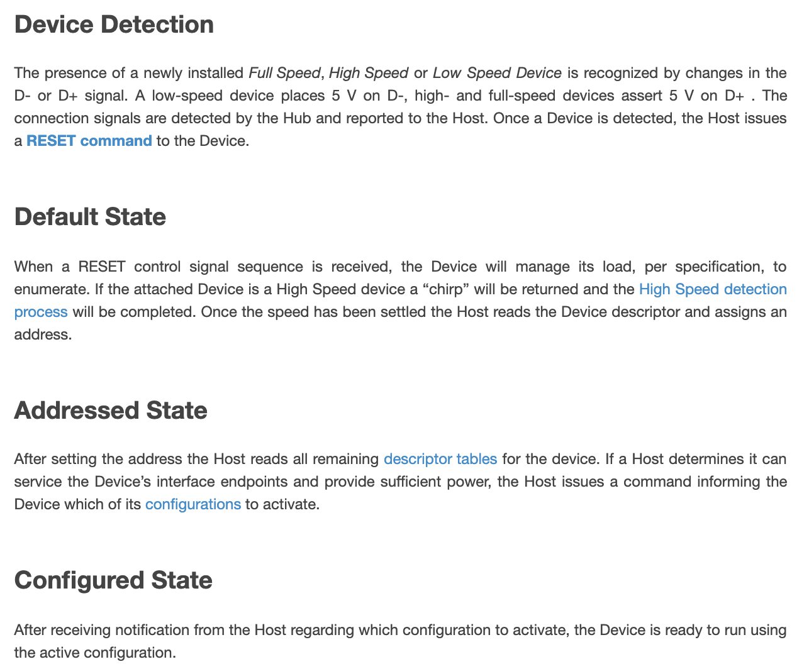

Slide 16
Video: troubleshooting tutorial 1 34 minutes
Artin Bogdanov
https://harvard.zoom.us/rec/share/v-5KAaP_711LZaeX5HOPe7d-AtvoX6a8gHQc-_oEmEb21dTkK8BshQSdOgMKso0v

Slide 17
Analog-to-digital converter (ADC)
In electronics, an analog-to-digital converter (ADC, A/D, or A-to-D) is a system that converts an analog signal, such as a sound picked up by a microphone or light entering a digital camera, into a digital signal. An ADC may also provide an isolated measurement such as an electronic device that converts an input analog voltage or current to a digital number representing the magnitude of the voltage or current. Typically the digital output is a two's complement binary number that is proportional to the input, but there are other possibilities.
There are several ADC architectures. Due to the complexity and the need for precisely matched components, all but the most specialized ADCs are implemented as integrated circuits (ICs).
A digital-to-analog converter (DAC) performs the reverse function; it converts a digital signal into an analog signal
From Wikipedia

Slide 18
The Analog World
Microcontrollers are capable of detecting binary signals: is the button pressed or not? These are digital signals. When a microcontroller is powered from five volts, it understands zero volts (0V) as a binary 0 and a five volts (5V) as a binary 1. The world however is not so simple and likes to use shades of gray. What if the signal is 2.72V? Is that a zero or a one? We often need to measure signals that vary; these are called analog signals. A 5V analog sensor may output 0.01V or 4.99V or anything in between. Luckily, nearly all microcontrollers have a device built into them that allows us to convert these voltages into values that we can use in a program to make a decision.
https://learn.sparkfun.com/tutorials/analog-to-digital-conversion

Slide 19
What is the ADC?
An Analog to Digital Converter (ADC) is a very useful feature that converts an analog voltage on a pin to a digital number. By converting from the analog world to the digital world, we can begin to use electronics to interface to the analog world around us.

Slide 20
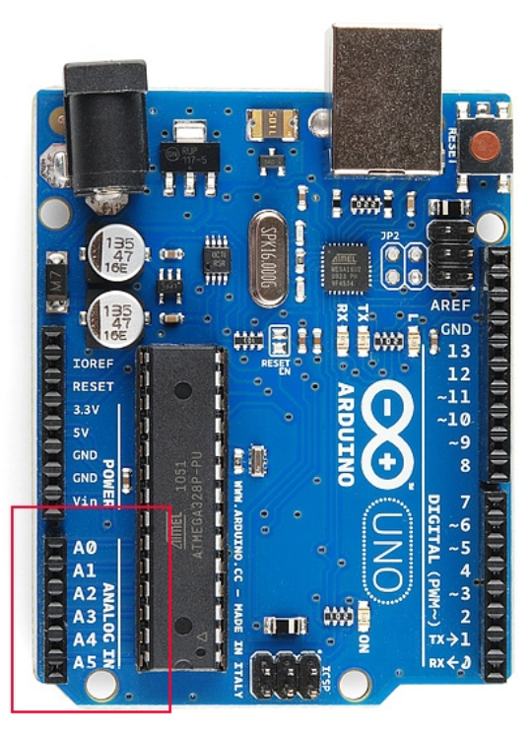
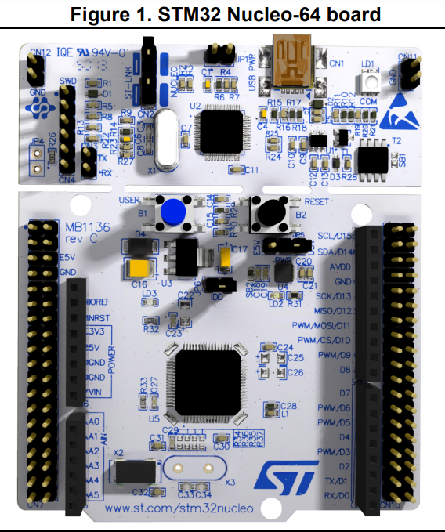
Analog Input
Arduino Uno
STM32 Nucleo NUCLEO-L476RG

Slide 21
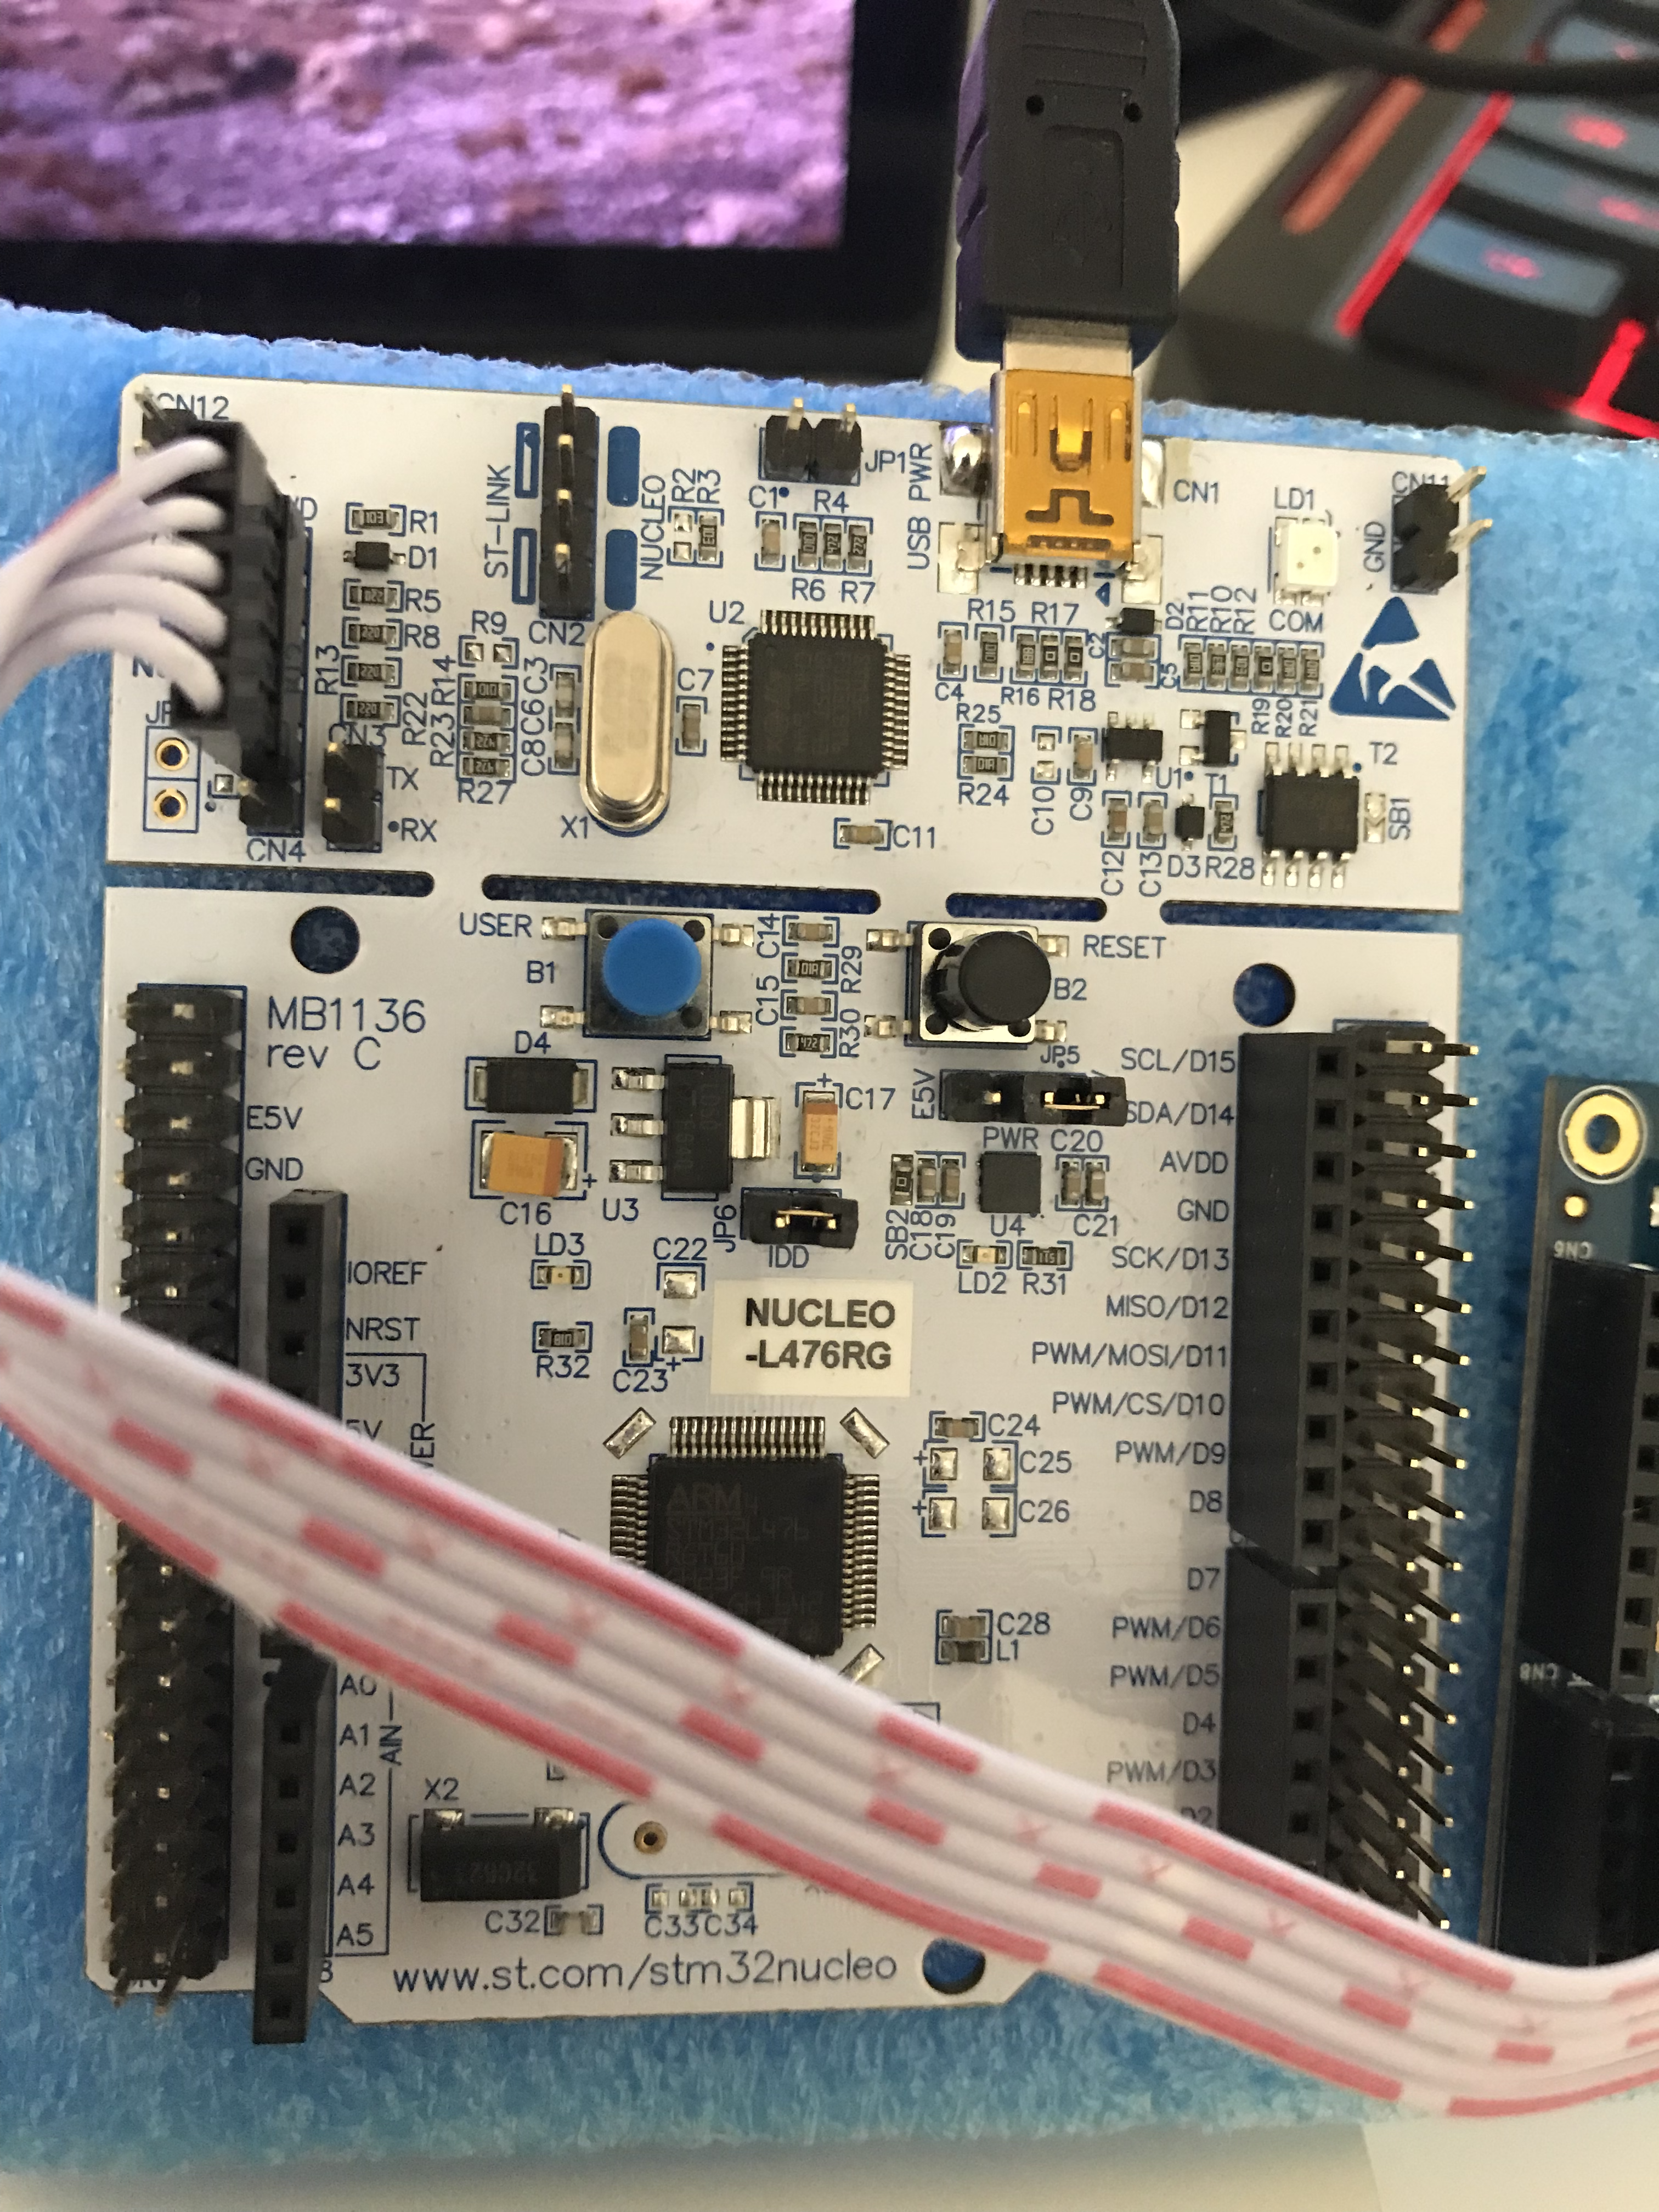
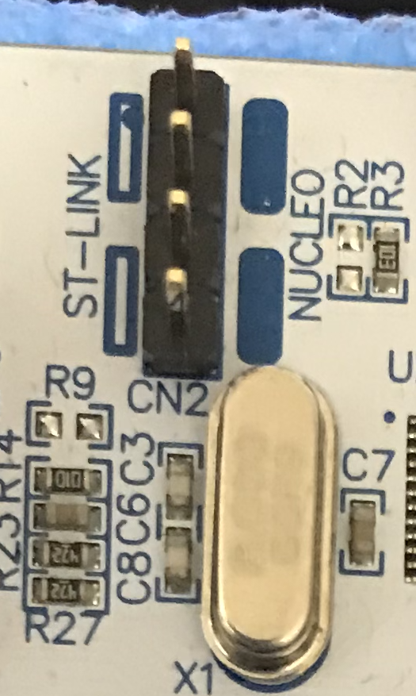
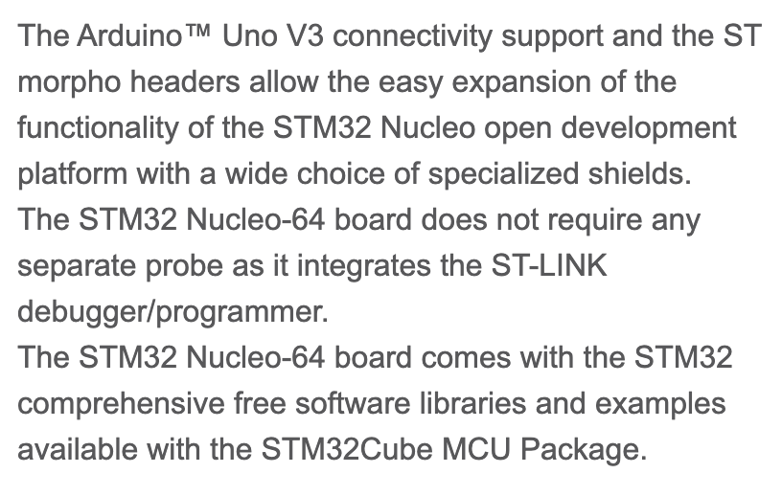
STM32 Nucleo-64 boards

Slide 22
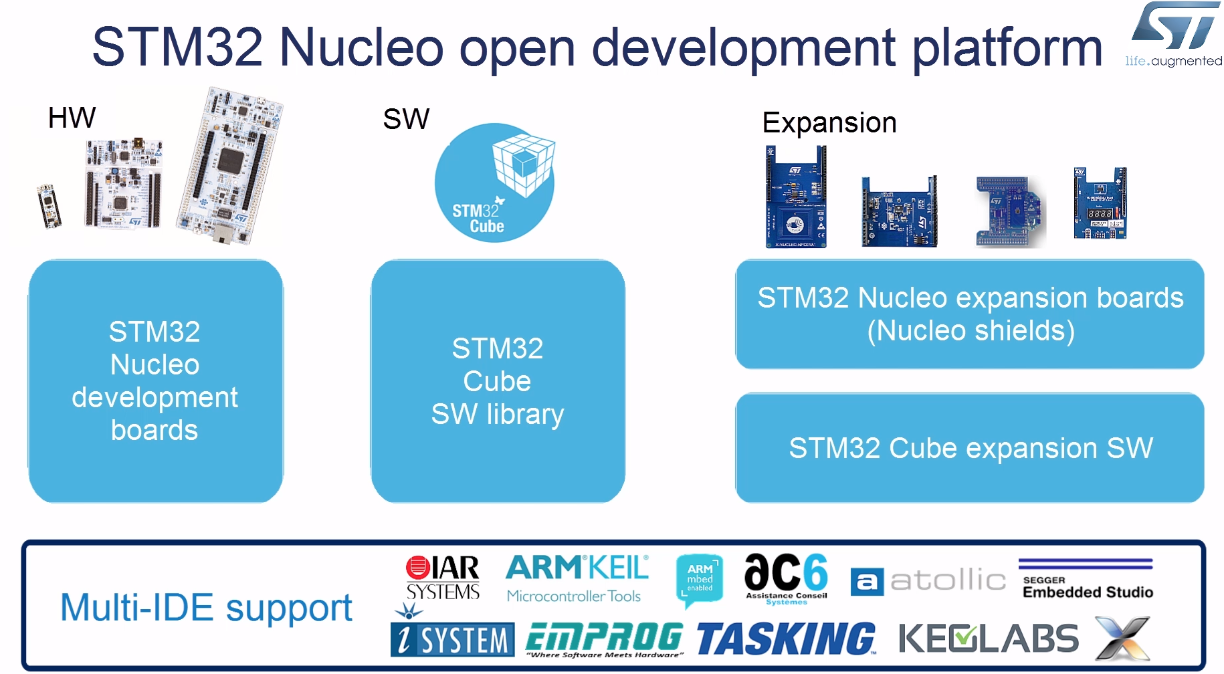

Slide 23
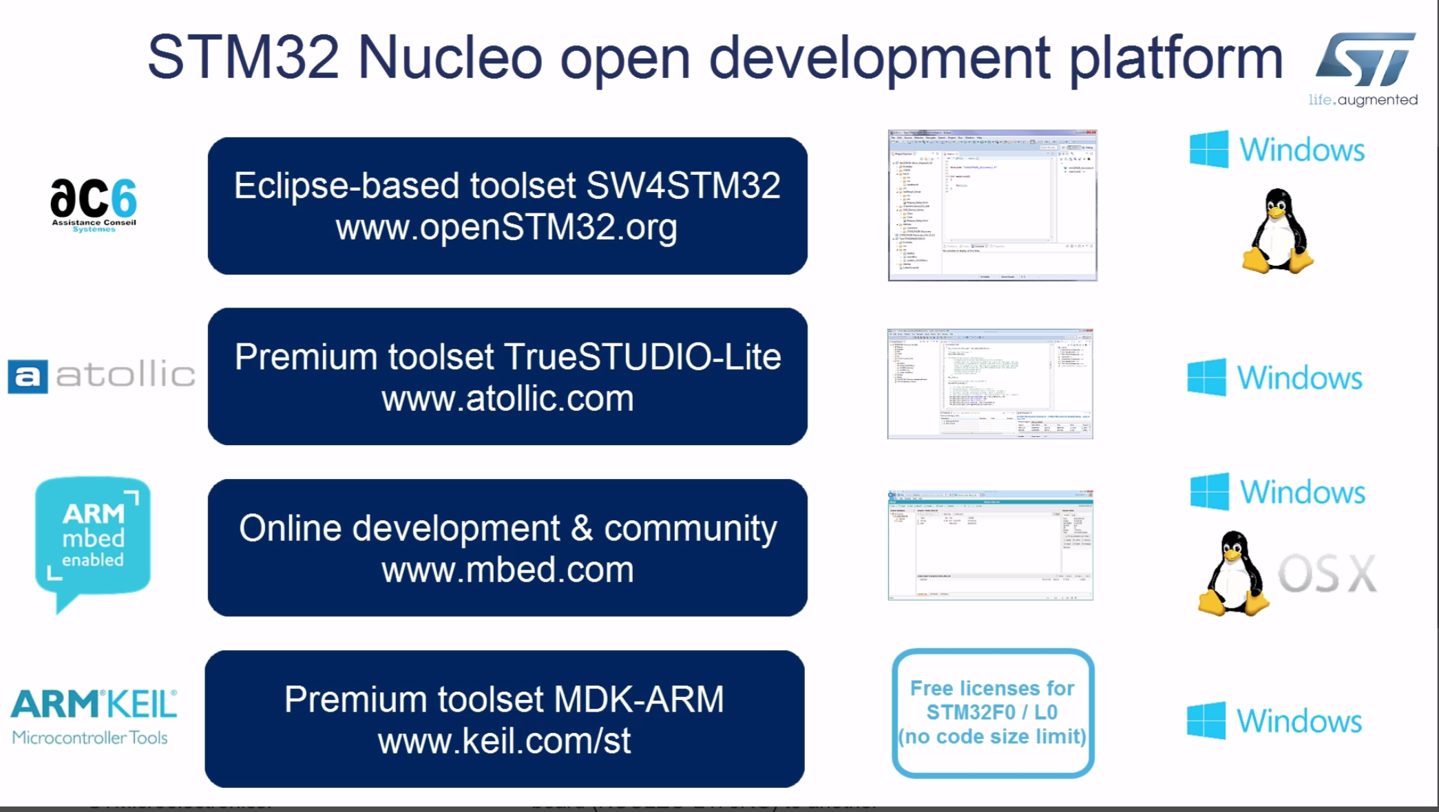

Slide 24
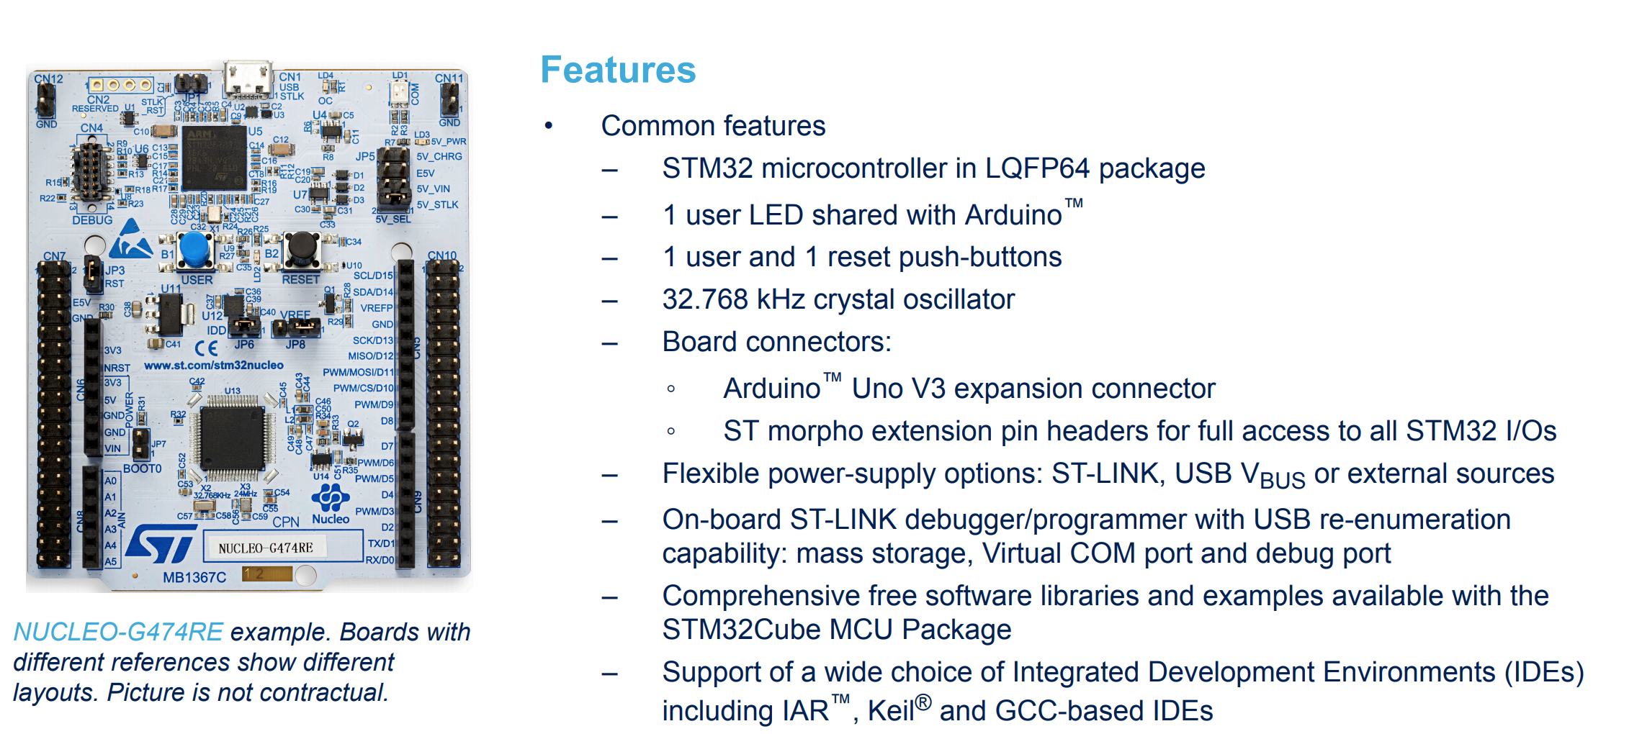

Slide 25
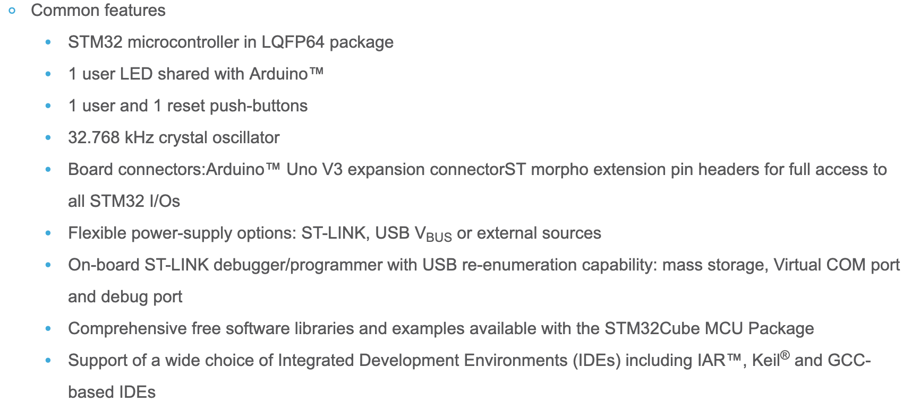

Slide 26
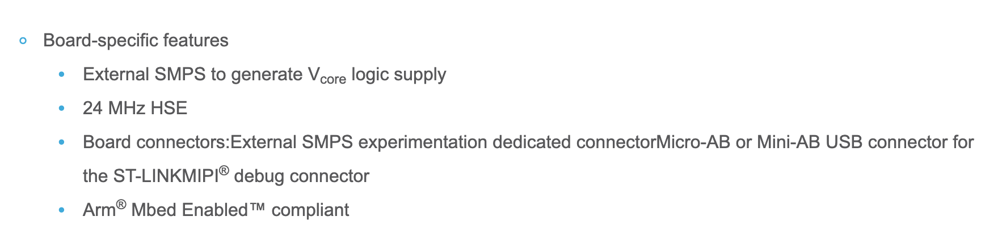

Slide 27

Pins A0 through A5
Not every pin on a microcontroller has the ability to do analog to digital conversions. On the Arduino board, these pins have an ‘A’ in front of their label (A0 through A5) to indicate these pins can read analog voltages.
ADCs can vary greatly between microcontroller. The ADC on the Arduino is a 10-bit ADC meaning it has the ability to detect 1,024 (2¹⁰) discrete analog levels. Some microcontrollers have 8-bit ADCs (2⁸ = 256 discrete levels) and some have 16-bit ADCs (2¹⁶ = 65,536 discrete levels).
The way an ADC works is fairly complex. There are a few different ways to achieve this feat (see Wikipedia for a list), but one of the most common technique uses the analog voltage to charge up an internal capacitor and then measure the time it takes to discharge across an internal resistor. The microcontroller monitors the number of clock cycles that pass before the capacitor is discharged. This number of cycles is the number that is returned once the ADC is complete.

Slide 28
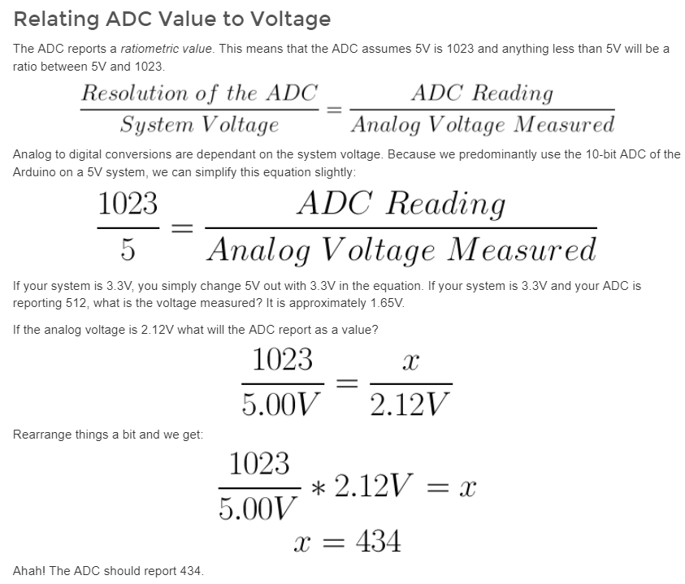
ADC

Slide 29
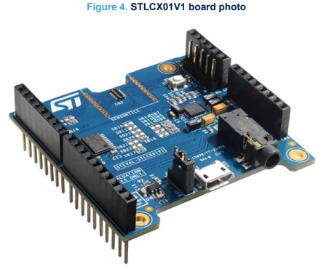
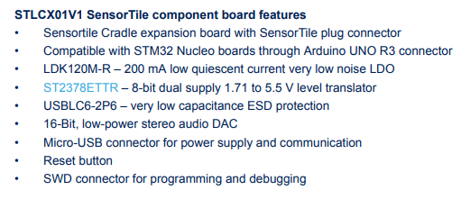
STLCX01V1 SensorTile component board

Slide 30
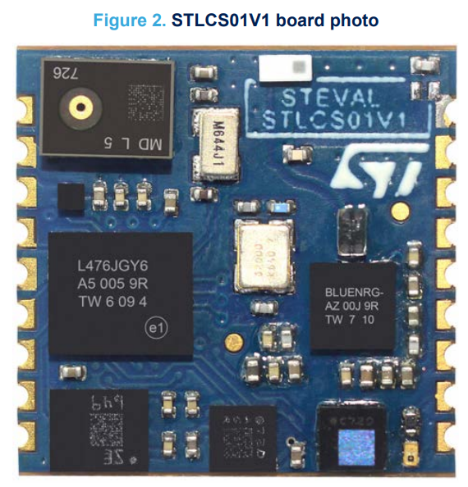
STLCS01V1 SensorTile component board features
• Main components:
– STM32L476JG – 32-bit ultra-low-power MCU with Cortex®M4F
– LSM6DSM – iNEMO inertial module: 3D accelerometer and 3D gyroscope
– LSM303AGR – Ultra-compact high-performance eCompass module: ultra-low power 3D accelerometer
and 3D magnetometer
– LPS22HB – MEMS nano pressure sensor: 260-1260 hPa absolute digital output barometer
– MP34DT05-A – 64 dB SNR digital MEMS microphone
– BlueNRG-MS – Bluetooth low energy network processor
– BALF-NRG-02D3 – 50 Ω balun with integrated harmonics filter
– LD39115J18R – 150 mA low quiescent current low noise LDO 1.8 V

Slide 31
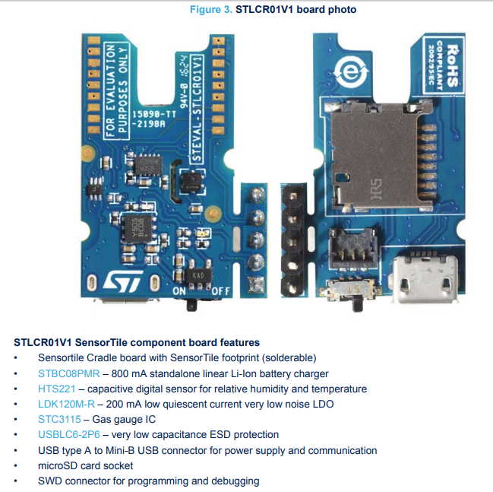
STLCR01V1 board photo

Slide 32
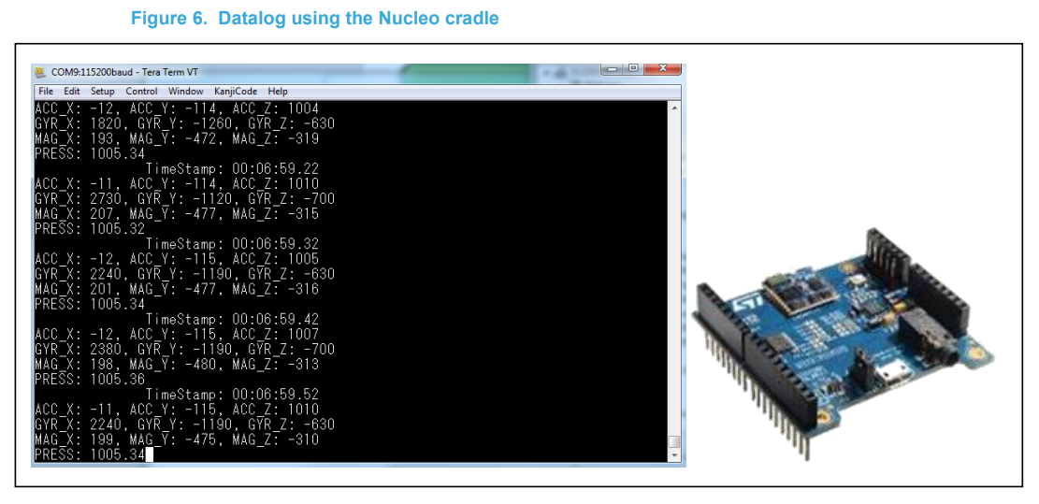
The datalog monitors the following sensor data and timestamp using the Nucleo cradle (see Figure 6): • Accelerometer
Gyroscope
Magnetometer
Pressure

Slide 33
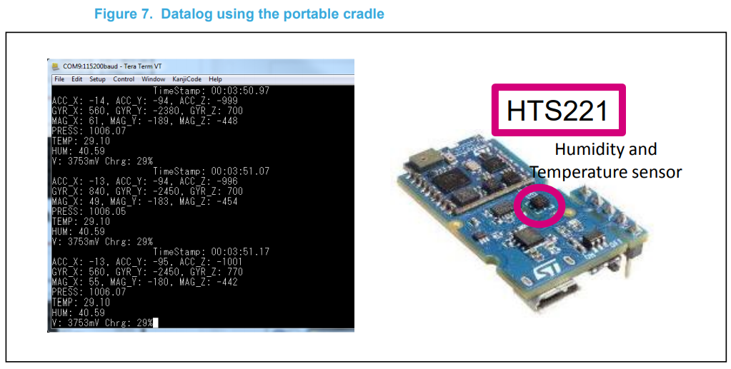
The datalog monitors the following
sensor data and timestamp
using the portable cradle
(see Figure 7):
Accelerometer
Gyroscope
Magnetometer
Pressure
Humidity
Temperature
Battery status

Slide 34
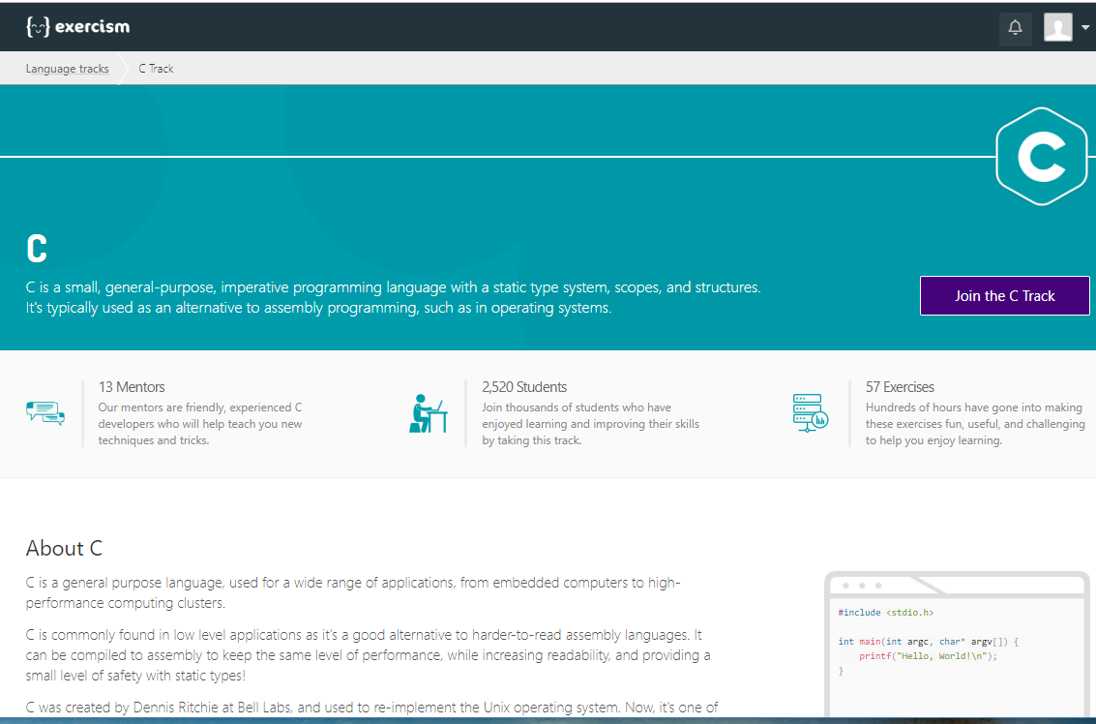
Coding practice - https://exercism.io/my/tracks/c

Slide 35
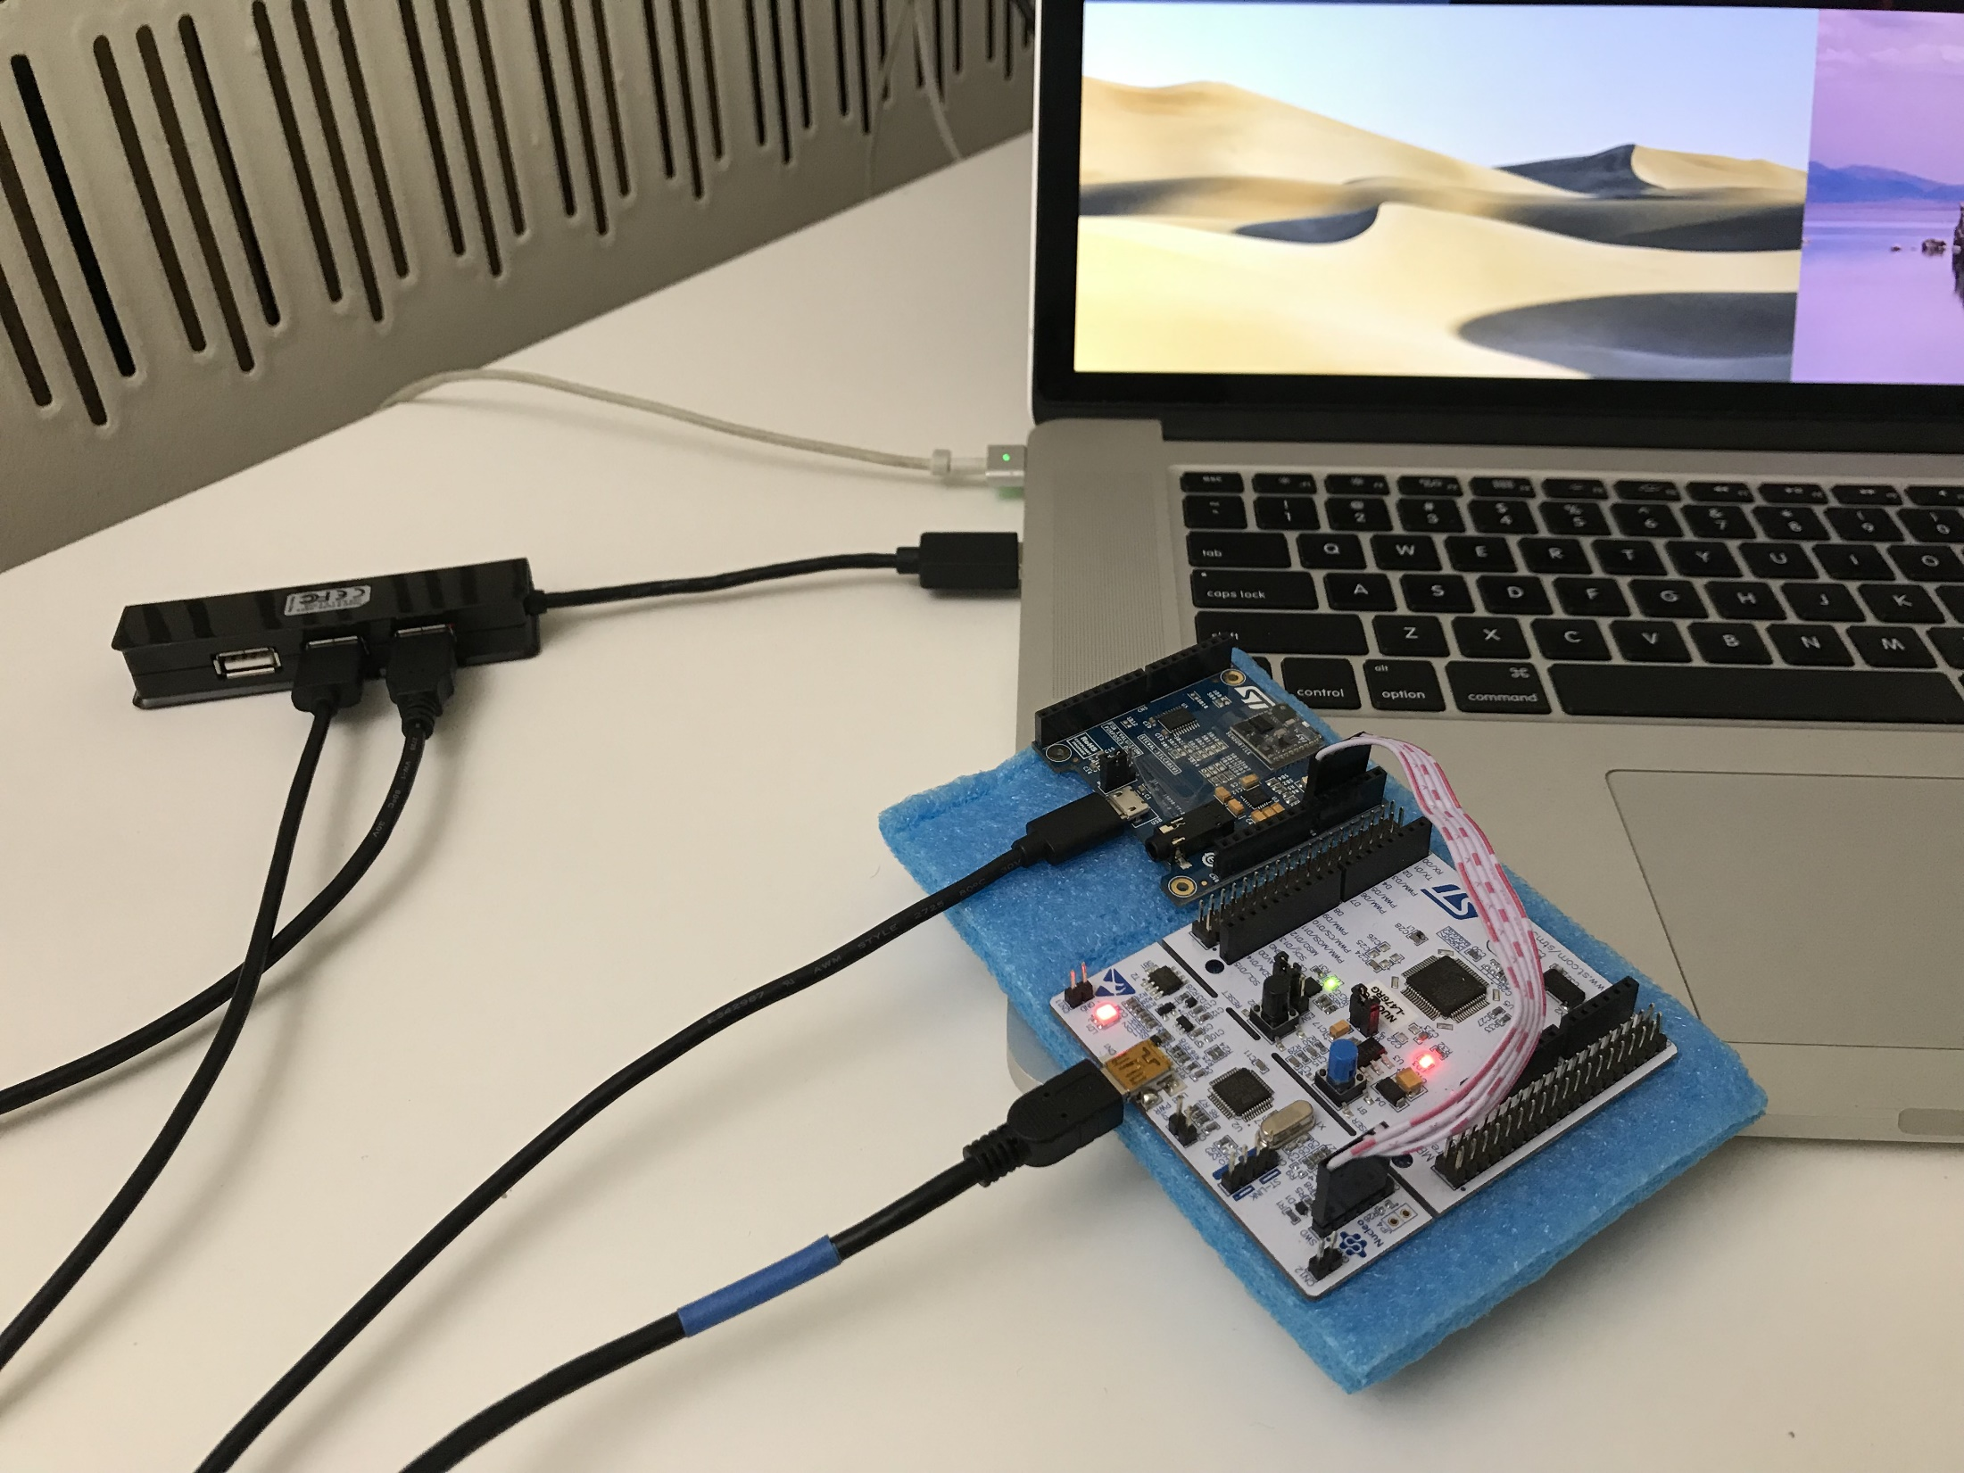
screen
Hands – on Tutorials 2
Putty

Slide 36
Break
7:40 pm – 7:50pm
Break
8:40 pm – 8:50 pm
6:30 pm – 7:30 pm
7:50 pm – 8:40 pm
8:50 pm – 9:30 pm
Part 1
Introduction
Part 2
Anaconda Python
Logistics
Image Processing with python
Questions
OpenCV4

Slide 37
full group discussion

Slide 38
Break
7:30 pm – 7:35 pm
Break
9:10 pm – 9:15 pm
Part 1
Introduction
Part 2
Hands-on Activity
Part 3
Office Hours
Questions?
Discussion
Projects + teams
Logistics
6:30 pm – 7:30 pm
7:35 pm – 8:35 pm
9:15 pm – 9:30 pm

Slide 39
Office hours
emails TA's:
sok462@g.harvard.edu
ricardo_villamil@fas.harvard.edu
Calendly me:
https://calendly.com/jlr682/wearable-devices-final-project

Slide 40
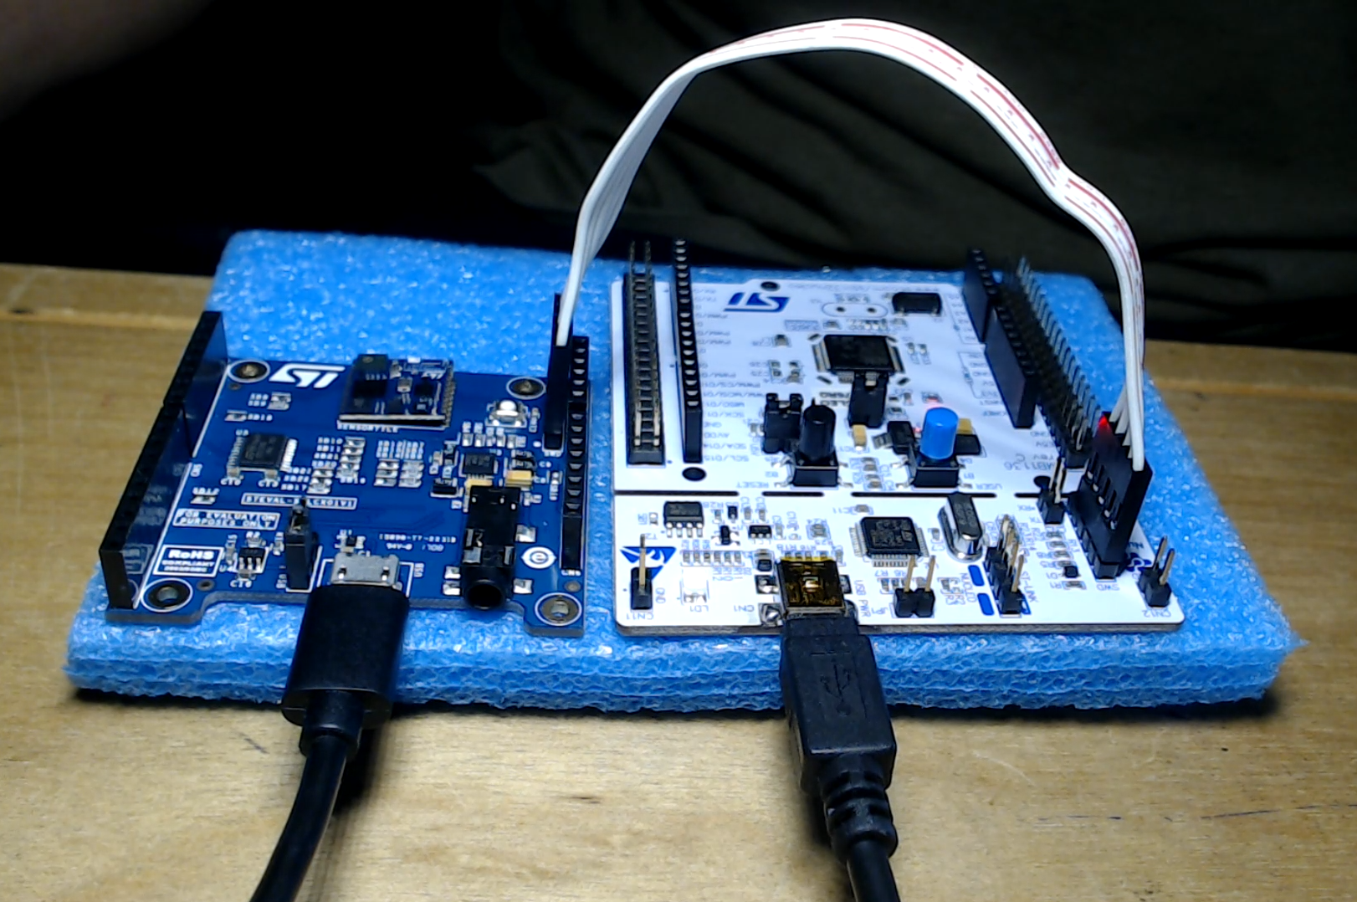
Connection
Serial Wire Debug (SWD)

Slide 41
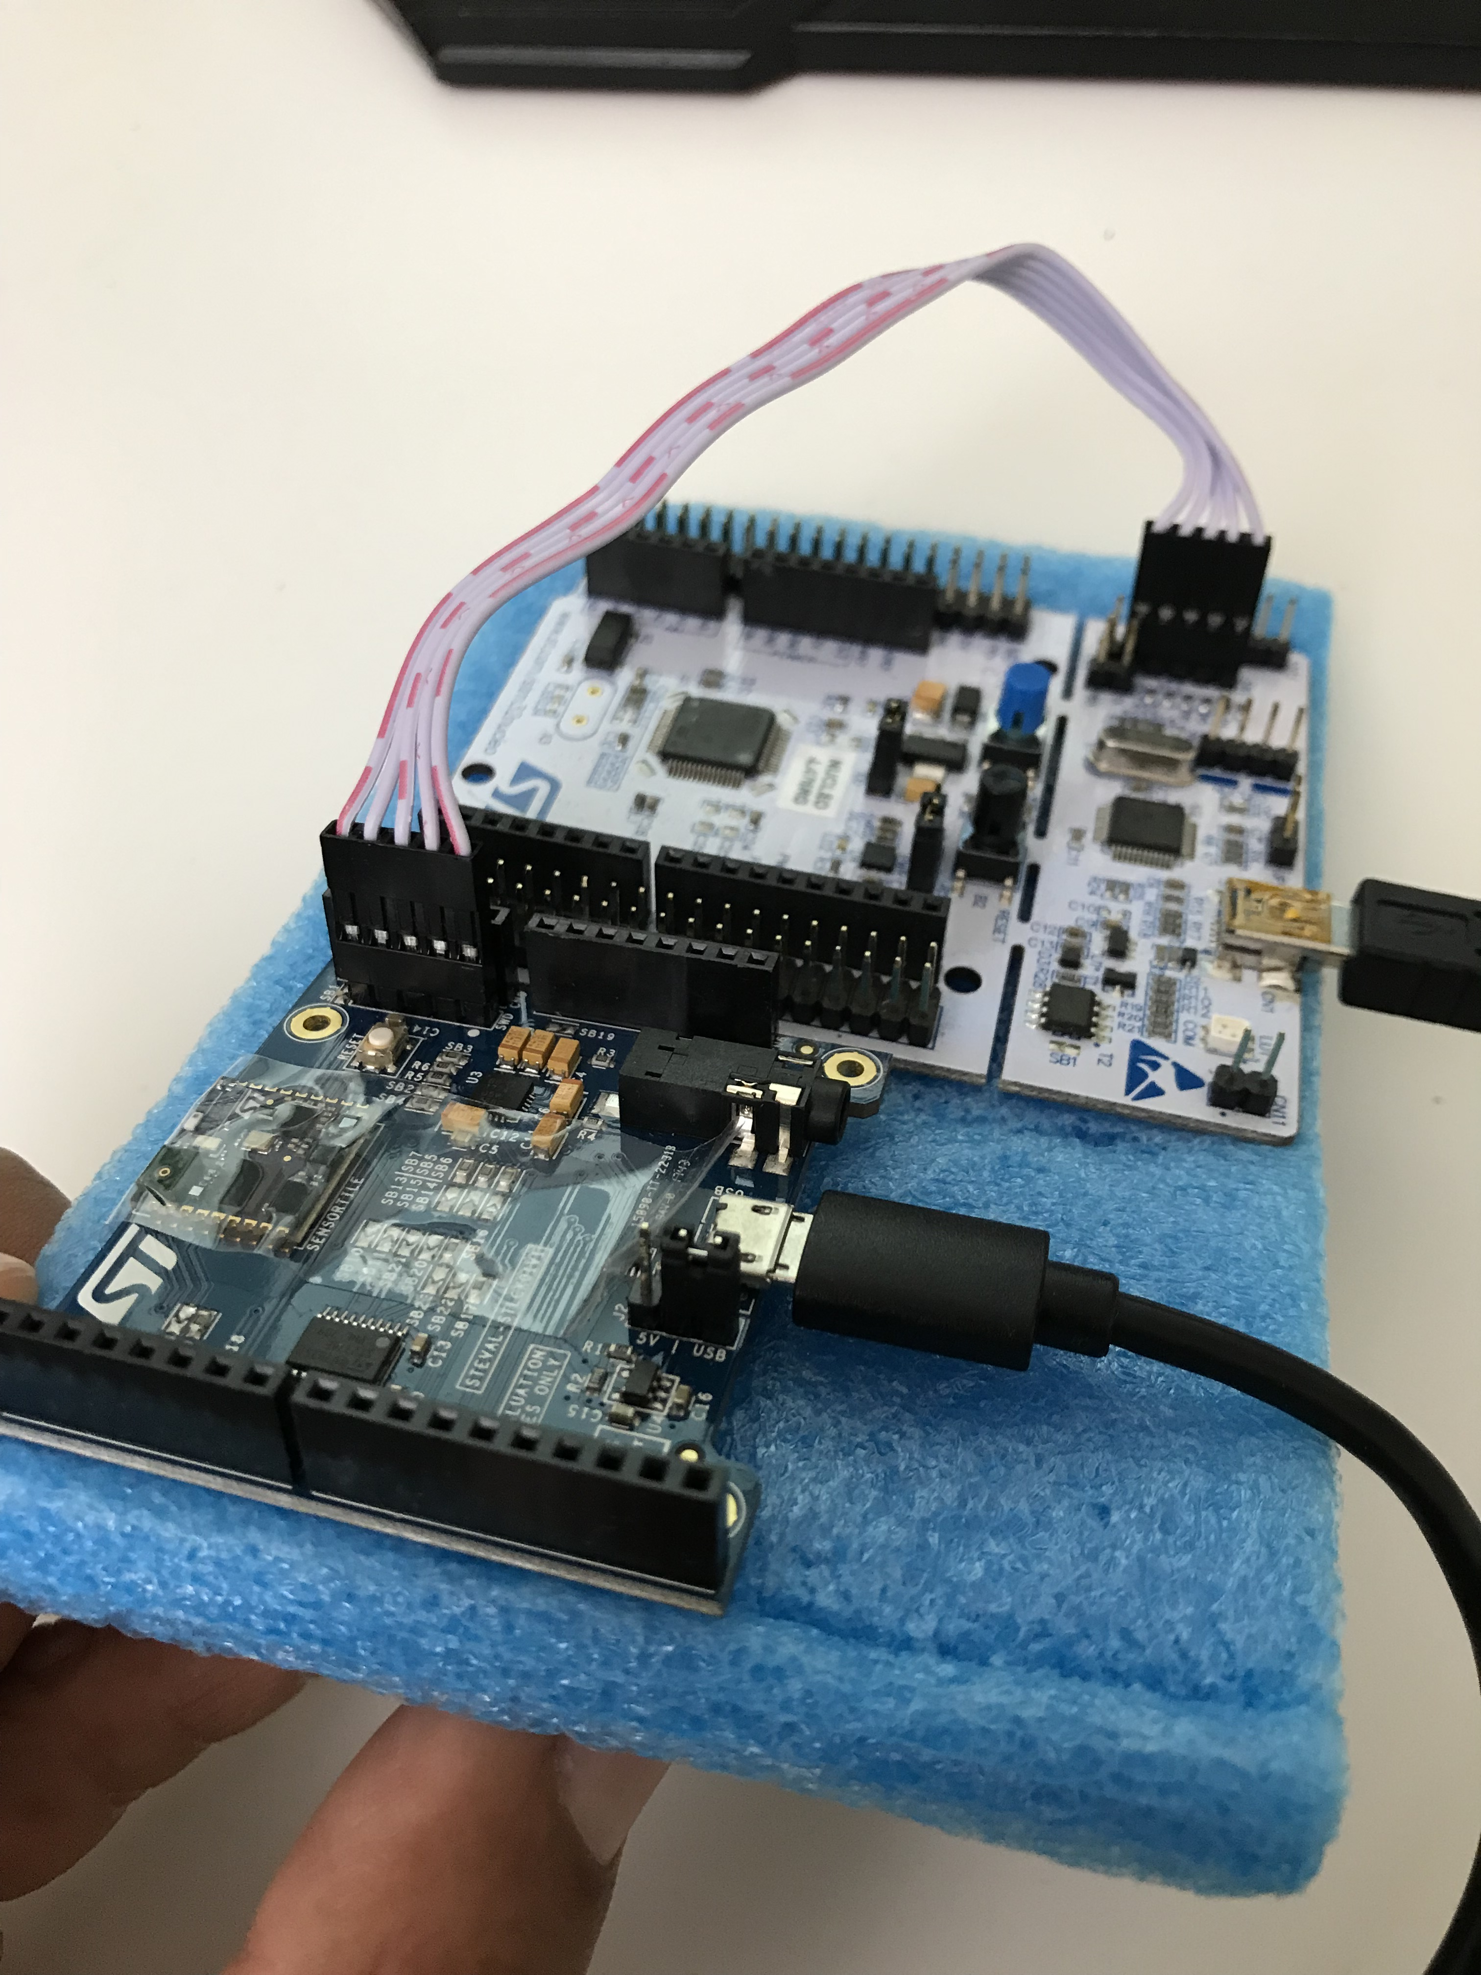

Slide 42
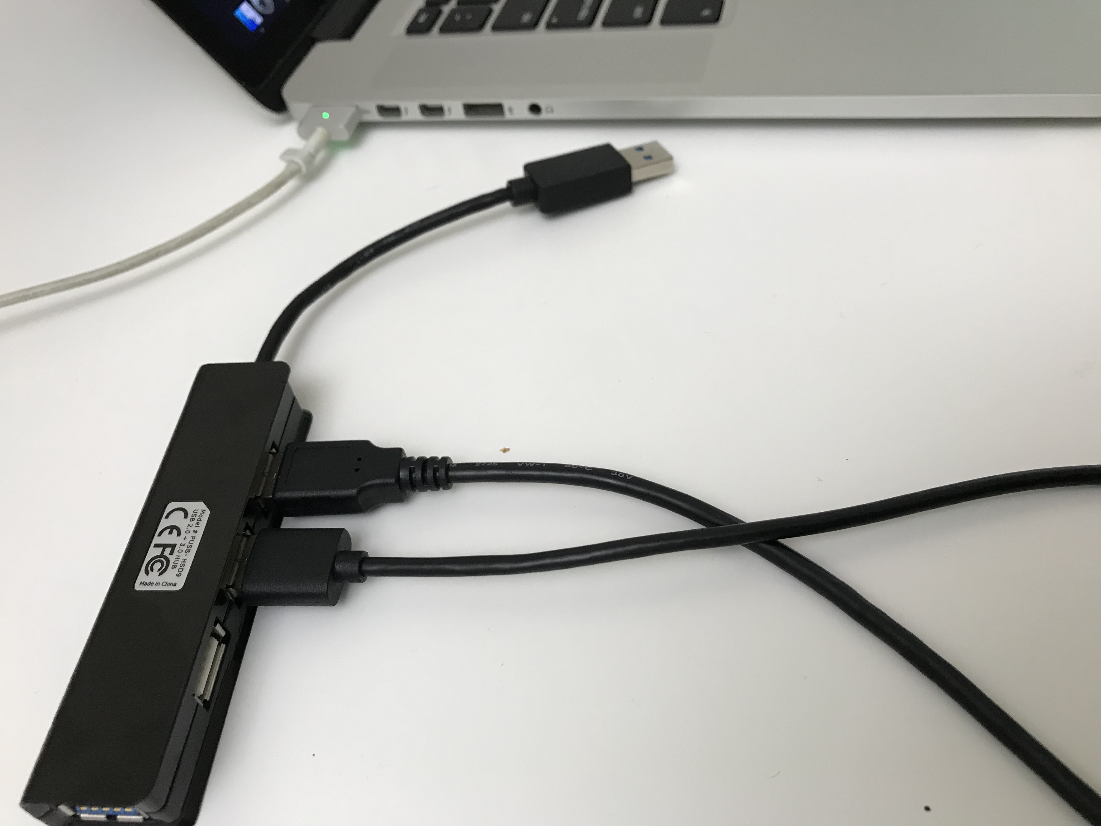

Slide 43


Slide 44
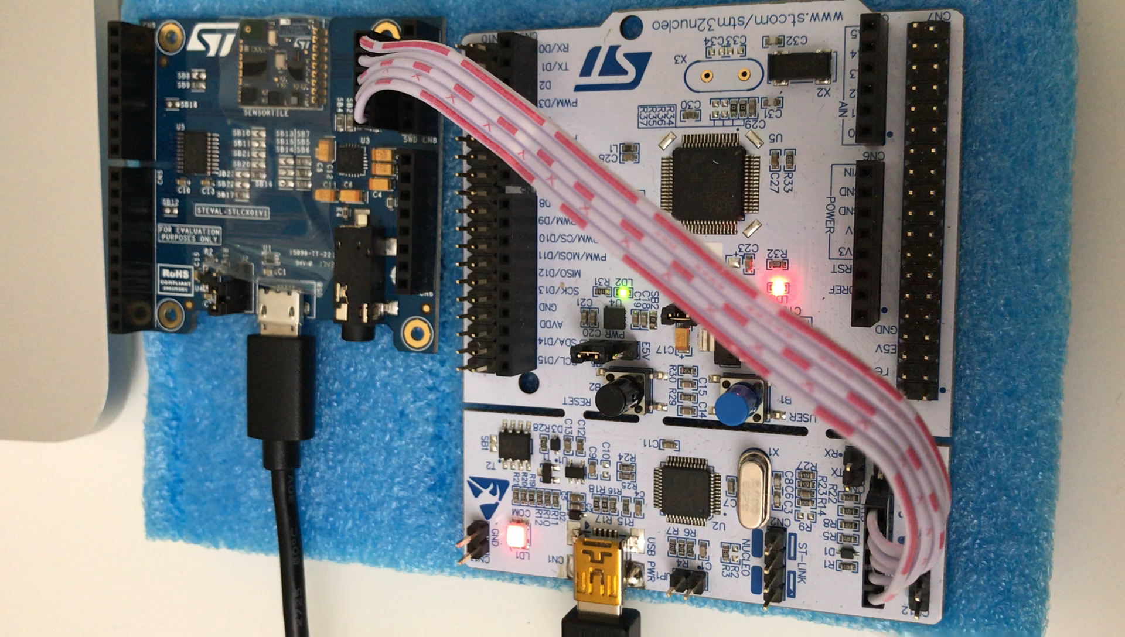

Slide 45
Projects

Slide 46
Student Project Reference Designs
1) STMicroelectronics SensorTile Reference Design: Basketball Freethrow Classifier by Machine Learning 2) STMicroelectronics SensorTile Reference Design: Basketball Hookshot Classifier by Machine Learning 3) STMicroelectronics SensorTile Reference Design: Tennis Motion Classifier by Machine Learning 4) STMicroelectronics SensorTile Reference Design: Resistance Training Motion Classifier by Machine Learning 5) STMicroelectronics SensorTile Reference Design: Climb On: A Climbing Motion Classifier by Machine Learning 6) STMicroelectronics SensorTile Reference Design: Shoulder Rehabilitation Motion Classifier by Machine Learning

Slide 47
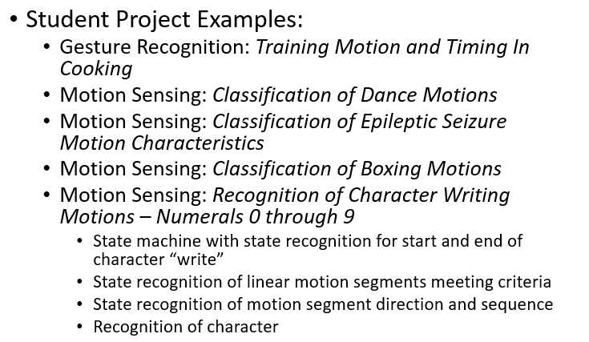

Slide 48
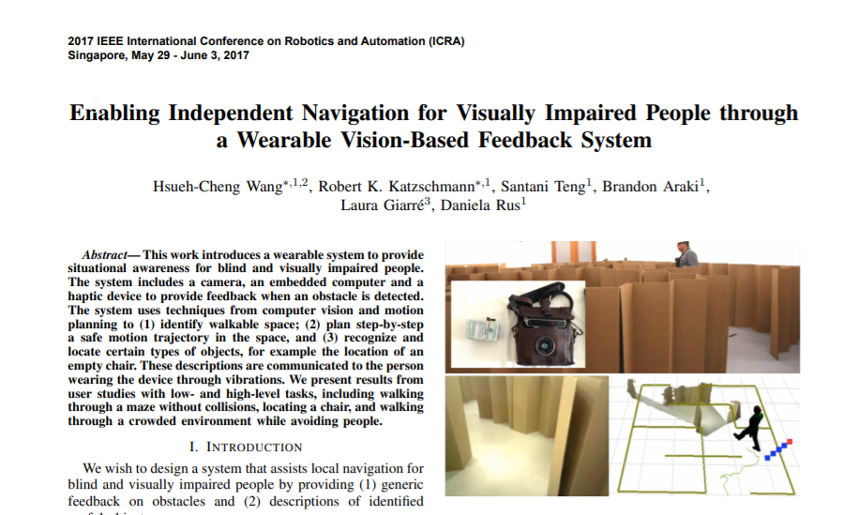

Slide 49
Students Project Reference Designs
STMicroelectronics SensorTile Reference Design:
Basketball Freethrow Classifier by Machine Learning
Basketball Hookshot Classifier by Machine Learning
Tennis Motion Classifier by Machine Learning
Resistance Training Motion Classifier by Machine Learning
Climb On: A Climbing Motion Classifier by Machine Learning
Shoulder Rehabilitation Motion Classifier by Machine Learning
Reference: https://sites.google.com/view/ucla-stmicroelectronics-iot/home

Slide 50
Possible Alternative Projects
Integration: SensorTile/s -> Cloud Service Visualization -> Data Analysis
-Integration: SensorTile/s-> Iot Service → ML Classifier
Integration: SensorTIle /s-> Game Engine
Other integration: SensorTile->SBC->Actuator

Slide 51
teams

Slide 52
past

Slide 53
Questions?

